Slide 1
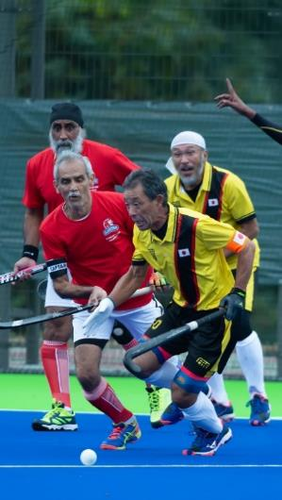
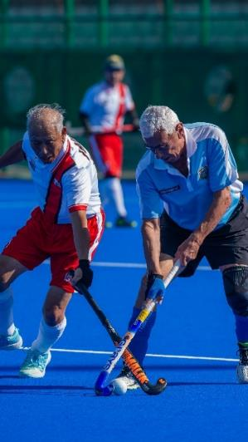
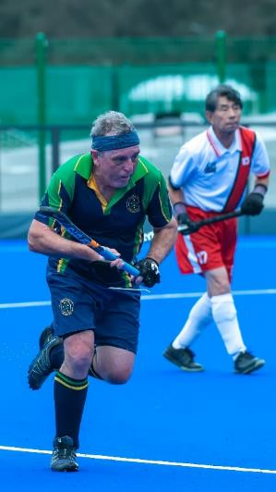
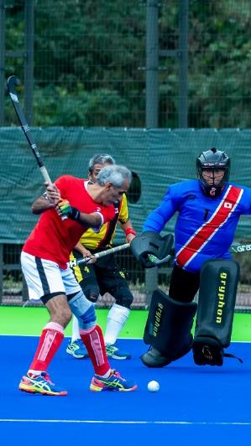
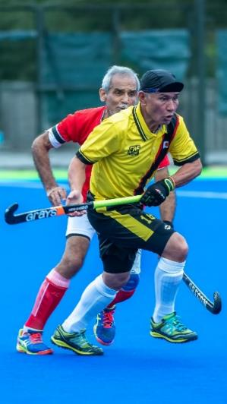
MASTERS
Men Over 60s,65s,70s,75s
WORLD CUP
TOKYO 2022
OI HOCKEY STADIUM
19 -29 OCTOBER
INFORMATION PACK Version 3

Slide 2
SPONSORS - 1
Official Partners
Be sure to support our Tournament Sponsors & Partners

Slide 3
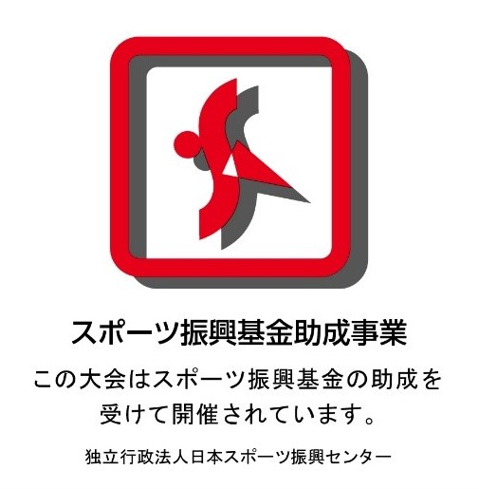
SPONSORS - 2
Official Supporters
Official Sponsors

Slide 4
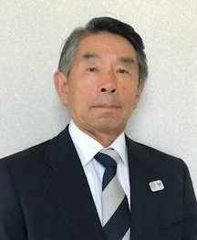
Welcome from Japan Hockey Association - 1
Dear Masters Hockey Friends,
First of all, I would like to thank WMH and masters hockey officials of national associations from across the world for your support for the WMH World Cup in Tokyo in 2022. As you are well aware, all WMH events scheduled to be held in 2020 and 2021 were postponed, so I would like to take this opportunity at last to welcome you all to Tokyo!
We have secured the two pitches at Oi Hockey Stadium, where the postponed Tokyo Olympic hockey was held in 2021. This will be the first time ever for a Masters World Cup to be held on official Olympic pitches, and we are sure the visiting teams and officials will enjoy the world-class facilities, and playing hockey on the near-perfect surfaces.
This event in the metropolitan area of Tokyo will also show the city inhabitants how senior people from all around the world are enjoying this sport as a life-long pastime. With life expectancy now reaching over 100 years, particularly here in Japan, I am sure that this tournament, showcasing some of the world’s fittest 60-80 year-olds, will impress many first-time viewers! (continued next slide…)
Junichi ‘Jimmy’ SEKIYA
President - Japan Masters
4

Slide 5
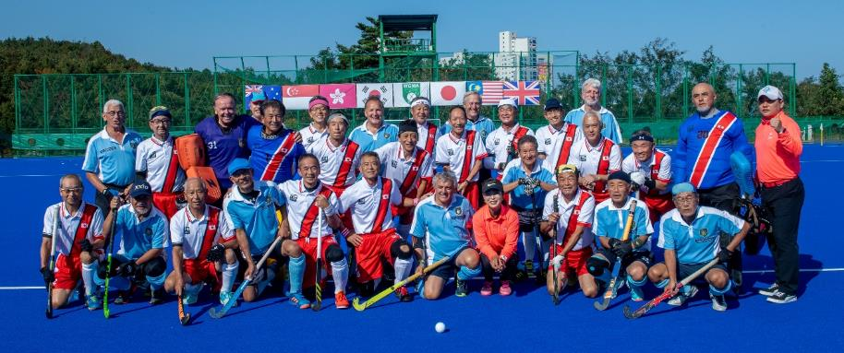
Welcome from JHA - 2
We would also like to acknowledge the enormous contribution of Mr Wim van Noortwijk to international Masters Hockey for the over 60s categories. Sadly, he passed away two years ago and this is the first World Cup to be held without his indominable energy and drive. We miss him greatly and know he would be very proud to see us all gathering together again like this in Tokyo.
Masters Hockey brings us meaningful chances for enriching our life, making new friendships, and connecting world societies. I am convinced that this WMH World Cup in Tokyo in 2022 will bring us all a great opportunity to revive old connections and create new friendships among international masters hockey players.
After such a long wait, we are really looking forward to welcoming all of the teams, officials, family members, and friends to the WMH World Cup in Tokyo. Yokoso and See you soon!
Very best wishes from,
Junichi ‘Jimmy’ SEKIYA
President - Japan Masters
5

Slide 6
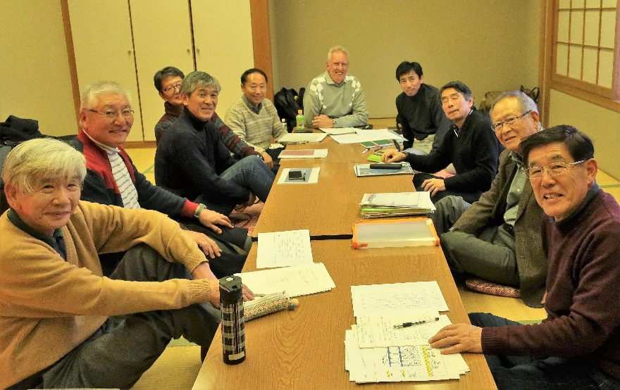
TOURNAMENT KEY DATES
KEY PERSONNEL
Event | Date | Location | Time
Tournament Director Pre-Event Information | Sep/Oct | On-Line Meetings | 0:00
Kit & Passport Check | Mon 17th and Tue 18th October | Oi Hockey Stadium (OHS) Main Pitch
Opening Ceremony | Tue 18th October | Oi Hockey Stadium (OHS) Main Pitch | 3:00pm
Team Managers Meeting | Tue 18th October | Oi Hockey Stadium (OHS) Main Pitch | 5:00pm
Exhibition Match | Sat 22nd October | Oi Hockey Stadium (OHS) Main Pitch | 5:30pm
Tournament Dinner | Fri 28th October | Meiji Kinenkan Garden | 5:30pm
Closing Ceremony | Sat 29th October | Oi Hockey Stadium (OHS) Main Pitch | Post Match
Position | Name
WMH President | Mr Glenn PATON
WMH Event Manager | Ms Ishbel DICKENS
Japan Masters President | Mr Junichi (Jimmy) SEKIYA
Japan Masters Secretary | Mr Kenji HAMANAKA
JHA Secretary General | Mr Nobuo ISHIKAWA
Tournament Director (TD) | Mr Kiyoshi SANA
Umpires Manager (UM) | Mr John HERON
WMH/JHA Liaison | Mr Kevin DEMPSTER
Visa Operations JHA | Mr Koichi UCHIYAMA
Venue & Equip Manager | Mr Yoshiya KANNO
Field of Play Coordinator | Mr Yutaka HIRAO
Information/Media Manager | Mr Yoshimitsu UMEZAWA
Accommodation Manager | Mr Fusao SATO
Medical Services | Mr Takeo ARAI
Photo: First meeting of Tokyo HNOC in Feb 2019

Slide 7
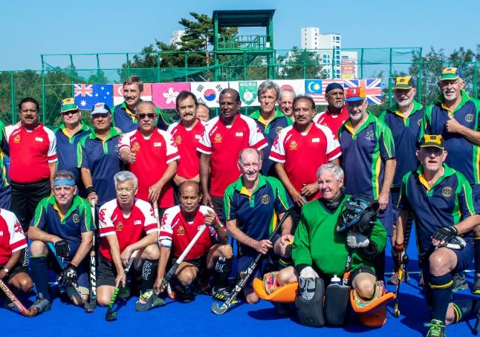
COMPETITION & TRAINING - 1
Teams Competing
We have 27 teams, representing 12 countries, competing at this World Cup event.
There will be games taking place all day long over the eleven days of the tournament on the two Olympic pitches at Oi Hockey Stadium.
Country/Team | O60 | O65 | O70 | O75
Australia
Canada
England
Ireland
Italy
Japan
Malaysia
Scotland
Singapore
South Africa
USA
Wales
Japan SoM
Alliance SoM
Southern Cross

Slide 8
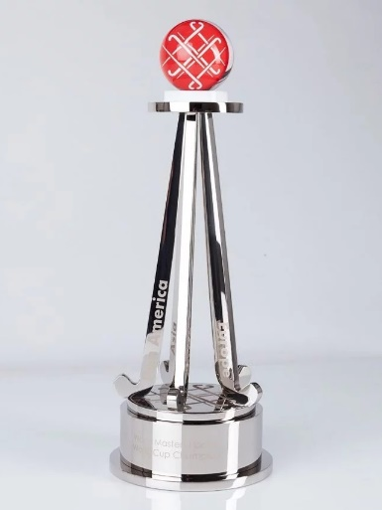
COMPETITION & TRAINING - 2
Competition Format
The teams will compete in the following pools:
 | Over 60 Men |  |  |  | Over 65 Men |  | Over 70/75 Men
 | Pool A |  | Pool B |  | Group |  | Pool A |  | Pool B
 | ENG |  | AUS |  | AUS |  | AUS 70 |  | WAL 70
 | JPN |  | SCO |  | JPN |  | JPN 70 |  | RSA 70
 | RSA |  | USA |  | IRE |  | SouthX SoM |  | ALL 70 SoM
 | ITA |  | SGP |  | RSA |  | JPN 75 |  | JPN 70 SoM
 | CAN |  | MAS |  | USA
 | JPN SoM |  | SouthX SoM |  | MAS
 |  |  |  |  | SouthX SoM
The winners of a match will be awarded three points, with one point awarded to each team in the event of a draw and zero for a loss. After all matches have been played, the ranking in each pool will be determined by total points, with ties broken by the total number of wins, then goal difference, then goals scored, then the result(s) of the match(es) between the two or more tied teams, then the number of field goals. If the teams remain tied after all these tiebreakers, a shoot-out competition (or penalty stroke competition for O/70s) will be held to determine the rankings.

Slide 9
COMPETITION & TRAINING - 3
Competition Format
The match schedule created by WMH and can be found at: https://drive.google.com/file/d/12HB9auG9JoOqCaOiK1JTG2ci_mgIOGRJ/view
The teams have been allocated to several pools based on their seedings. The format of the competition will be as per WMH Competition Handbook Part B
Over 65s Men
6 teams, 1 SoM team
One Pool 7 teams
SoM team ranked 7th in Pool (SoM Final not applicable)
Round Robin followed by:
Class 1 & 2 Final (1st v 2nd in Pool)
Class 3 & 4 Classification Match (3rd v 4th in Pool)
Class 5 & 6 Classification Match (5th v 6th in Pool)
Over 60s Men
10 teams, 2 SoM teams
Pool A: 6 teams & Pool B: 6 teams
SoM teams ranked 6th in each Pool
Round Robins followed by:
Class 1-4: 4 team Semi-finals (1st & 2nd in each Pool)
Class 5-8: 4 team Classification (3rd & 4th in each Pool)
Class 9 & 10 Classification Match (5th A v 5th B)
Spirit of Masters (SoM) Final (6th A v 6th B)
Over 70-75s Men
4x70 teams, 3x70 SoM teams, 1x75 team
Pool A: 4 teams & Pool B: 4 teams
75 team ranked 4th in Pool A (Final not applicable)
70 SoM team ranked 3rd in Pool A;
70 SoM teams ranked 3rd & 4th in Pool B
Round Robins followed by:
70 Class 1-4: 4 team Semis (1st & 2nd in each Pool)
70 Spirit of Masters (SoM) Elimination &Final
(3rd A v 4th B; Winner v 3rd B; Loser ranked 3rd)
75 team & 70 SoM teams non-competitive matches

Slide 10
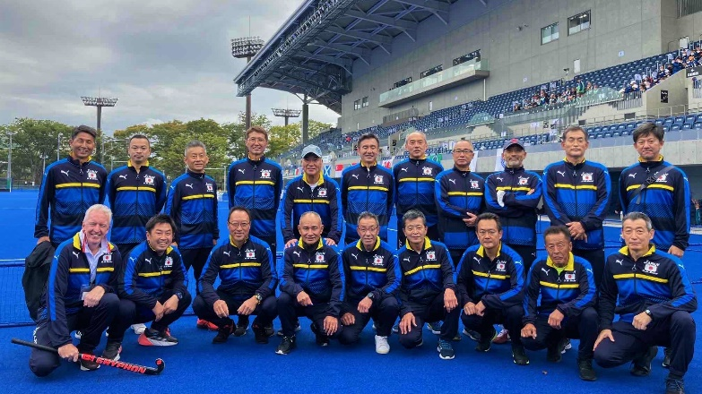
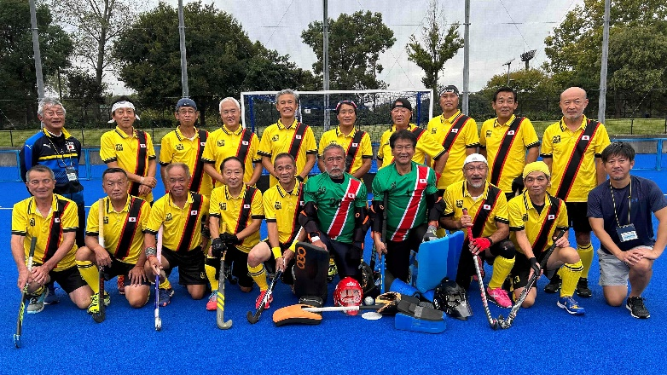
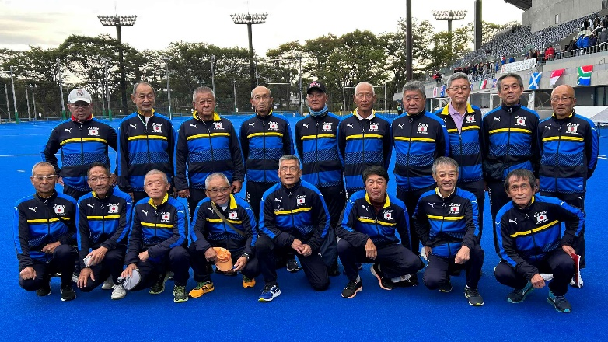
Teams – Japan (Host Nation)
Japan O/60s
Japan O/65s
Japan O/70s
1 | WADA Shinji (GK)
4 | NISHIDA Kei (GK)
5 | MATSUI Terumasa
6 | MAKIMOTO Satoshi
7 | YAMADE Yuji
8 | TAKII Miyoharu
9 | TAKESHITA Tetsushi
10 | TAKAMORI Koji (C)
11 | DEMPSTER Kevin
12 | TOKUI Hirokazu
13 | SAWADA Masahiro
14 | DEGUCHI Atsuhiro
15 | KANAYAMA Ryuichi
16 | ARAI Yoshio
17 | UESUGI Kazunori
18 | MOCHIZUKI Hiroaki
25 | UEDA Tomoyuki
26 | TACHIKAWA Zenichiro
1 | HAMAOKA Koji (GK)
2 | TOKUMASU Masayuki
3 | MATSUO Hideo
4 | SAGO Shigeharu
5 | HOSHI Masami
6 | YUZAWA Mutsuto
7 | ISHIKAWA Nobuo
8 | MOTOMURA Hirofumi
11 | YOSHIDA Takaaki
12 | KAWASHIMA Shim
13 | KUNIHIRO Toshiharu
15 | MIZUTANI Yoshio (C)
16 | TAKAKURA Teruhisa
18 | ASANO Kazuo
19 | KOYAMA Takashi
20 | AOTA Hiroshi (GK)
21 | HASEGAWA Masanao
50 | GOTO Yukio
1 | HASHIMOTO Keiichi
2 | USHIBANA Koji
3 | IMOSE Shuji
4 | YOSHINARI Hiroyuki
5 | KAWAKAMI Hoji (C)
6 | SATAKE Haruo
7 | SHIKANO Ikuro
8 | TAKASE Muneyasu
9 | YAMAMOTO Takeo
10 | TSUTSUMI Masaaki
11 | YOKOTA Nobuaki
14 | TOJIGAMORI Osamu
17 | MIZOKAMI Masaharu
30 | TOGASHI Kazushi (GK)
32 | HIRAO Takafumi
33 | TAJIMA Mitsuyuki
34 | KUCHIDA Junji
36 | NAKANISHI Takeyoshi
KATO Hiroshi - Manager
AMEMIYA Hideo -Physio
MASUOKA Tomoyuki -Physio
KAWANISHI Norihide – Physio
SAHARA Hikaru - Manager
AMEMIYA H -Physio
MASUOKA T -Physio
KAWANISHI N – Physio
KATO Hiroshi - Manager
AMEMIYA Hideo -Physio
MASUOKA Tomoyuki -Physio
KAWANISHI Norihide – Physio

Slide 11
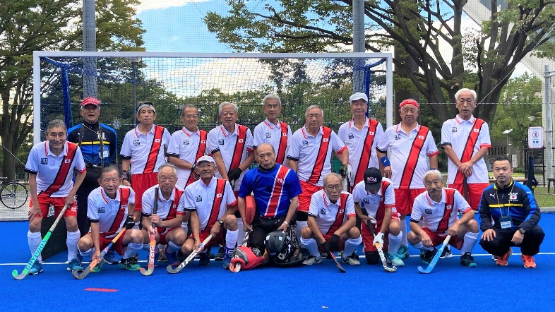
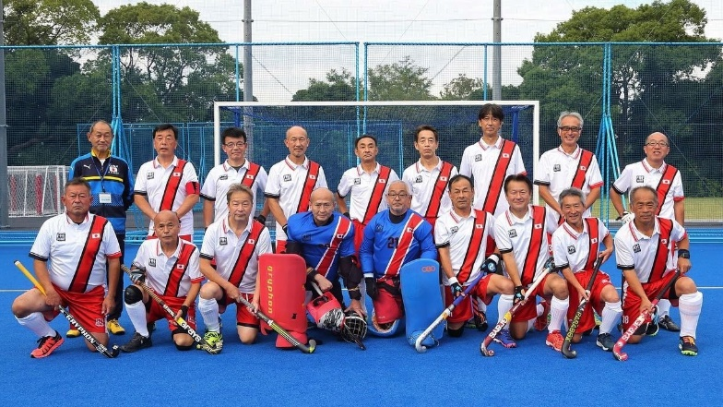
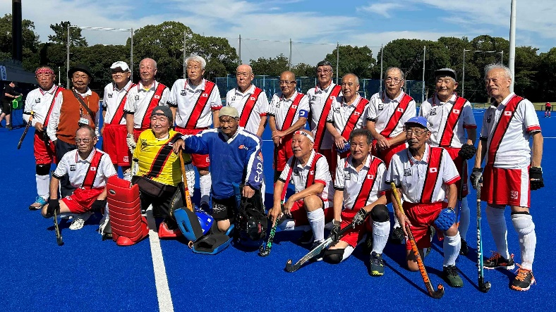
Teams – Japan (Host Nation)
Japan O/75s
Japan SoM O/60s
Japan SoM O/70s
1 | OHTA Hideki (GK)
2 | ISHIZAKI Eiji
3 | TANIGUCHI Suguru
4 | HIGASHIHARA Hiroaki
5 | MIYAMOTO Ryuso (C)
6 | YOSHIUCHI Masaaki
7 | MORISAKA Toshiaki
9 | AMEMIYA Saburo
10 | OKUSHIMA Shunsuke
12 | SEKIYA Junichi
14 | MIZUTANI Taichi (GK)
15 | KAMIMURA Yukio
16 | TSUTSUI Yasutoshi
18 | MATSUMOTO M.
19 | YOSHIDA Yoshihiro
22 | TSUJI Yasuo
20 | KAWAKAMI Masatomo
21 | FUKUYAMA Takehiko
22 | ABE Kenji (C)
23 | SASAKI Sakae
24 | SAWAURA Setsuo
27 | TAKAHASHI Sunao
29 | NAKAJIMA Yasuhito
32 | TAMURA Hajime
33 | SAKAI Jun
34 | YASUKURA Hiroshi
35 | UCHIYAMA Koichi
36 | SHIBATA Takuro
37 | KANNO Yoshiya
38 | MATSU Yoshikazu
39 | KATO Masafumi
40 | KISO Yasuharu
41 | ITO Yasukiyo
42 | ITSUKI Yoshio
1 | NAKAMURA Yoshio
23 | SOGABE Hiroshi
24 | MINAMIZAKI Shigeru
25 | ARAI Takeo
26 | NISHIGAKI Takendo
27 | KISA Yasuhiko
31 | ASAI Toru (C)
36 | HAMANAKA Kenji
37 | SUSUKI Tosaku
38 | FURUZAWA Tamotsu
39 | KAMIO Toyohiko
40 | OKAMOTO Arihiro
42 | YAMAOKA Toshihiko
43 | YAMADA Toshifumi
44 | SUGA Masanori
45 | YAMADA Akihiro
46 | ABURA Kazuhiko
KATO Hiroshi - Manager
AMEMIYA Hideo -Physio
MASUOKA T. -Physio
KAWANISHI N. – Physio
SAHARA Hikaru - Manager
AMEMIYA Hideo -Physio
MASUOKA T. -Physio
KAWANISHI N. – Physio
SHIMOMURA T. - Manager
AMEMIYA Hideo -Physio
MASUOKA T. -Physio
KAWANISHI N. – Physio

Slide 12
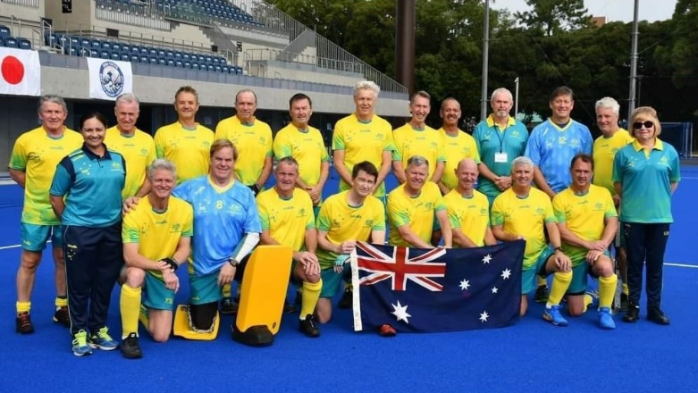
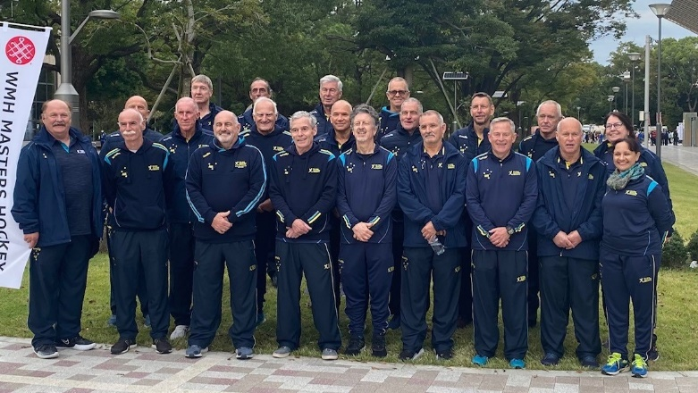
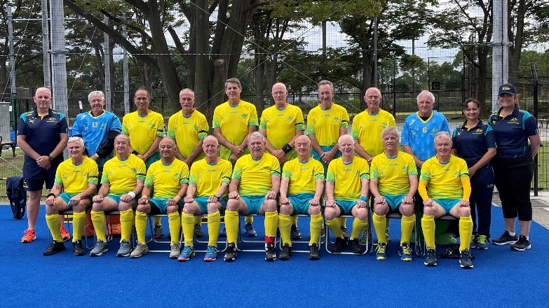
Teams – Australia
Australia O/60s
Australia O/65s
Australia O/70s
Tony Jones
Alan Kidd
Kevin McLaughlin
Bruce Buchanan
Craig Burgess
Michael Collins
Alan Ferguson
Martin Ferrari
Ian Ferreira
Warren Jenkins
Lyle Kenny
David McPherson
Brian Robinson
Bede Rogers
Philip Price
Philip Shaw
Stephen White
Simon Winter
Coach: Cameron Fairbrother
Manager: Sue Hollier
Physio: Sharon Dixon
Paul Murray
David Campbell
Don Bowser
Mark Finch
Clive Harrison
Paul Leadbeatter
Peter Mann
Dennis Martin
Mark McElligott
Robin Meagher
Robert Redding
Geoff Robinson
Norman Same
Stephen Sawyers
Peter Shepherd
Paul Spencer
Don Trewin
Peter Urie
Coach: Rob Lawson
Manager: Carolyn Campbell
Physio: Sharon Dixon
Denis Lovell
Rod Dyson
Winton Inkster
John Chapman
Barry Collins
Neil Coster
Trevor Dancer
Noel French
John Hearne
John Hore
12. Rudy Keswick
Robert McNeil
Raymond Northwood
Don Sanders
Col Shepperd
Richard Staynor
Ronald Tippet
Coach: Craig Williams
Manager: Susan Reid
Physio: Sharon Dixon

Slide 13
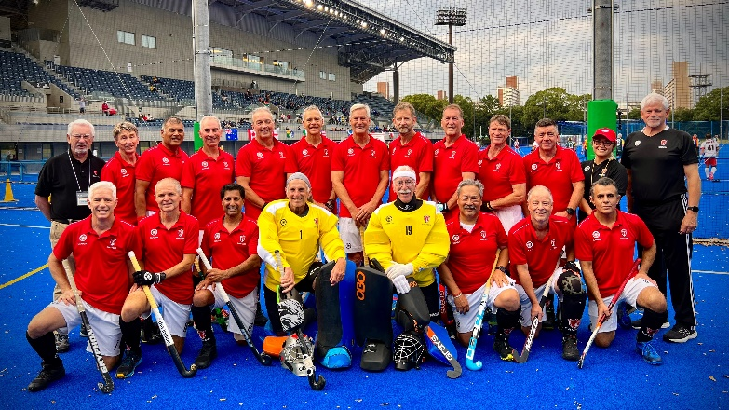
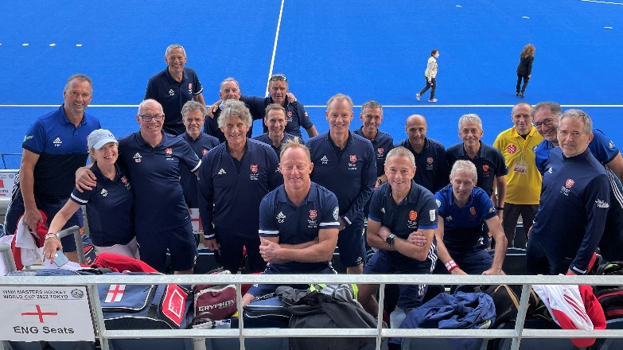
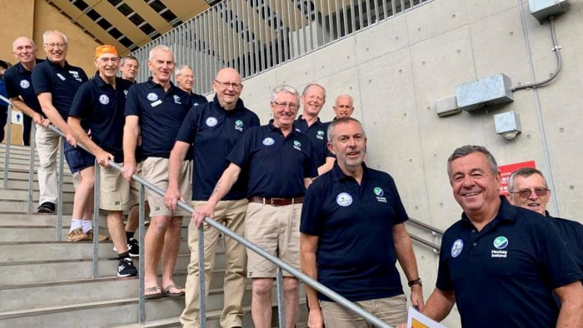
Teams – Canada, England, Ireland
Canada O/60s
England O/60s
Ireland O/65s
Peter Jardine
3. Dave Bissett
4. Bubli Chohan
5. Stephen Dearing
6. Andrew Haigh
7. Mark Hamilton
8. Jim Jenkyns
9. Gursharan Jheeta
10. Landon Kitagawa
11. John McCulloch
Perry Mody
Mark Northcote
Peader O’Riain
Patrick Oswald
Seamus Parker
Gord Plottel
Robert Stowe
Mike Millard
Mark Boothroyd
Rob Leach
Keith Hall
Jon Peplow
Chris Picken
Andy Law
John Russell
Avtar Khangure
Peter Jakob
Andy Batchelor
Rod Naughalty
Mark French
Richard Milbourn
Mike Pell
Nigel Bower
Jim Laslett
David Knapp
Rob Brown
Coach: Angus Batchelor
Manager: Sarah Pell
Tim Hogg
24. Stuart Switzer
26. Fergus Stapleton
27. Eddie O’Malley
28. Keith Jess
34. Billy Pollock
35. Stuart Egner
39. Richard Clarke
46. Henry Brown
49. Martyn Cremin
53. Carl Collings
68. Brendan Rice
79. Andy Matthews
83. Charlie Taylor
84. Billy Dowie
86. Roger West
101. Tim Myers
111. David Kiernan
Coach: Sean Curran
Manager: Norma Clarke
PATERSON Don | Manager
HOBKIRK Alan | Coach
MCCULLOCH Juli | Doctor
MUTH Theo | Physio

Slide 14
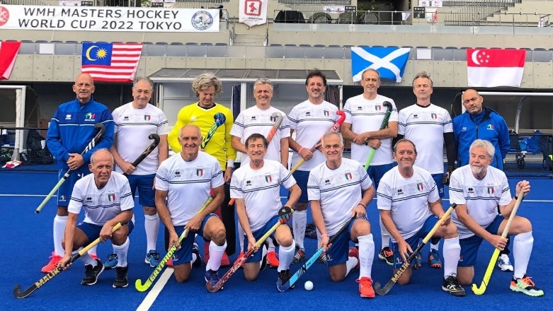
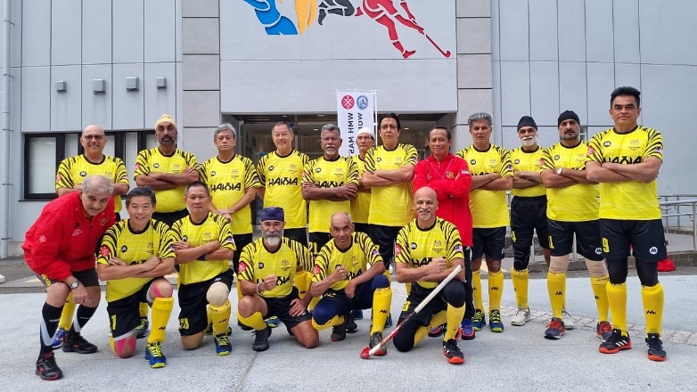
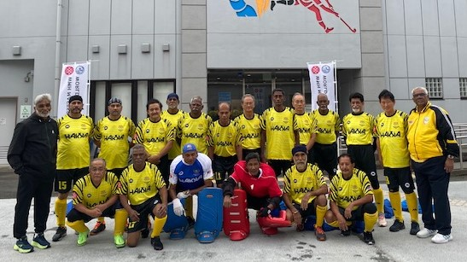
Teams – Italy, Malaysia
Italy O/60s
Malaysia O/60s
Malaysia O/60s
2. Antonio Parisi
4. Gigi Maggiolo
5. Giuseppe Congera
21. Giovanni Marziale
36. Carlo Ziccardi
38. Giovanni Chegia
52. Piero Bafaro
54. Vittorio Loli
55. Roberto Casablanca
58. Paolo Tosetto
60. Gianroberto Congera
82. Massimo Massera
97. Claudio Scialanca
99. Stefano Brandizzi
Manager: Antonio Spignolo
1 | M JOSEPH John Stephenson
2 | MUKHTIAR SINGH Avtar
4 | ATTAR SINGH Manjinder
5 | SUNDAR SINGH Harjit
6 | SINGH Sarjit
7 | HOOI Ka Choy
8 | MAHAN SINGH Harmohan
9 | TARA Inderjit
10 | CHIN Sow Ten
11 | MINDER SINGH Surjan
12 | BIN ABDUL AZIZ Mohd Nasir
1 | BIN YAHAYA Azmi (GK)
2 | BIN ABDULLAH Faizal
3 | ONG Seng Leong
4 | BIN MOHAMMED ASHRAF Kassim
5 | KANMANI Tharmalingam
6 | ARULANTHU Anthony Samy
7 | SUNDAR SINGH Hari Singh
8 | AMAR SINGH Mohindar Singh
9 | BIN ABDULLAH Abd Razak
10 | THIND Hussanpal Singh
11 | BIN HUSSIN Mohd Noor
15 | SARJIT Awtar
16 | KOAY Teng Hin
17 | DAVID Raymond
18 | SEE Zoo Thai
17 | DHALIWAL Surindar (C)
21 | P VELAIUTHAM Chandra.
23 | SEQUERAH Collin
25 | JESWANT SINGH Krishan
JAUHARI Zaiharin | Manager
SINGH Sarjit | Coach
ZAABA Mond | Physio
BALASINGNAM K "Bala"
- Team Manager
MURPHY James
- Head Coach
13 | MARKS TIO Raymond
15 | SHAH Azman
16 | BIN ABDULLAH Shamsul
12 | BIN TAWANG Ahmad Saufy
13 | MURUGESAN Mahendran
14 | FRANCIS XAVIER Gerard

Slide 15
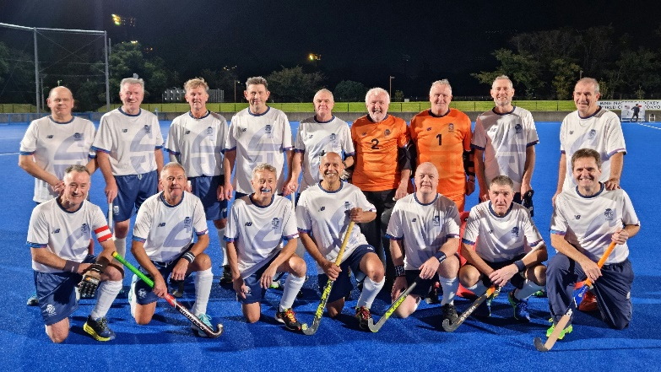
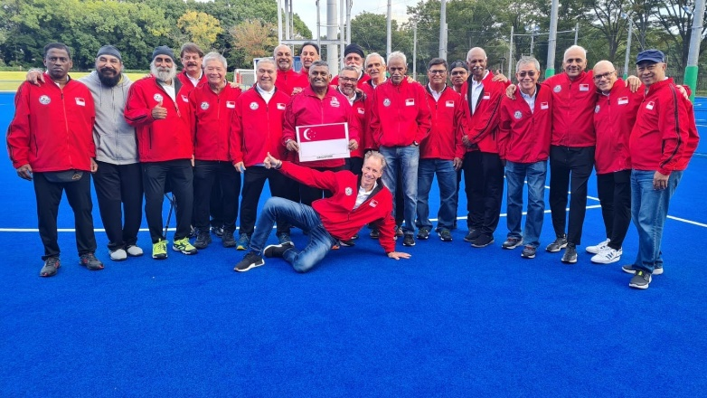
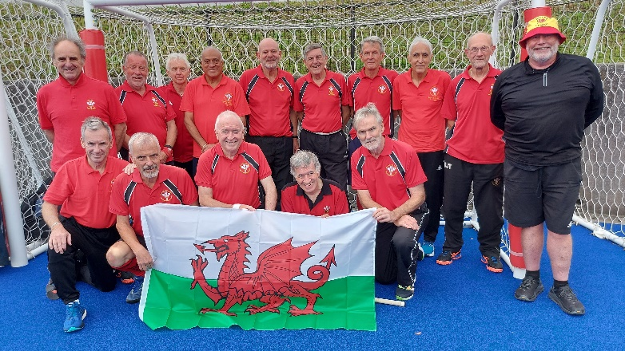
Teams – Scotland, Singapore, Wales
Scotland O/60s
Singapore O/60s
Wales O/60s
1. Scott Chisholm
2. Ronnie Stott
7. Billy Taylor
10. Niall Sturrock
13. Benny Gibson
17. Derek Johnstone
41. Dave Sutherland
43. Brian Edwards
44. Timothy Walker
45. Stephen Springthorpe
48. Mike Yellowlees
Mike Gilbert
Neil Sharp
Gurdial Duhre
Alan Kerr
Arthur Robertson
Derek Bell
Coach: Neil Taylor
Manager: Anne H-Chisholm
Physio: Lucy Thompson
Doctor: Rachel Sutherland
Mural Nair Chandra
Uttam Baksheesh Singh
Ilango Somasundaram
Parminder Singh
Hans Sluijser
Raj Patel
Ali Abdul Rahman
Shekar Velu
Kiran C R Sharma
Johnson Vedhamuthu
Idris Mohamad Nasir
Meng Chew
Adam Lee
Kumar Sundry
Suki Sandhu
Sardol Baghail
Satnam Suba Singh
Hernaikh Singh
Coach: Nordin Manaff
Manager: Arul Subramanian
2 | CHAPMAN Richard
4 | HARBOTTLE Richard
6 | HAVLIN Peter
7 | JOHNSON Ian
8 | SUMAL Inderpal
9 | WRIGHT Derek
10 | LOTA Nari
12 | MONTGOMERY Nigel
14 | RICHARDS Dave
15 | SMITH John
21 | WHEATER Philip
22 | WITHERS Phil
23 | WYATT Antony
24 | HARRIS Roger
25 | ROBINSON Jeff
28 | PADMORE Malcolm
30 | WILLIAMS John Peter
31 | TIPPER Dave (GK)
MITCHELL Andy | Coach
PADMORE Karen | Manager
CHAPMAN Richard | Manager

Slide 16
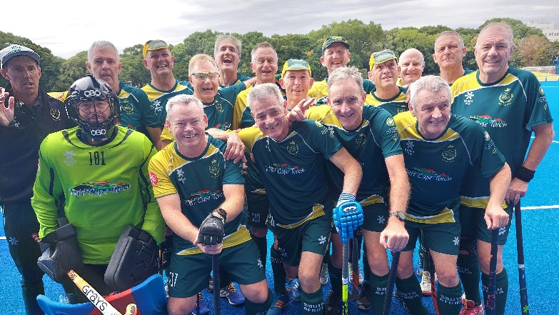
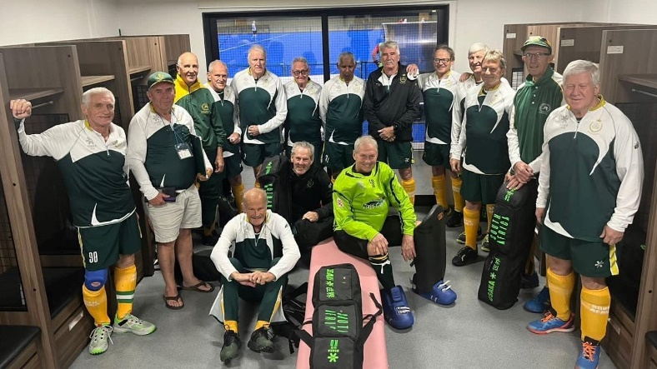
Teams – South Africa
South Africa O/60s
South Africa O/65s
South Africa O/70s
8 | PELL Steve
101 | METHVEN Gary
102 | SHANKLAND James
103 | TURNER Glenn
104 | SOUTHERN Mark
105 | ETHERINGTON Richard
108 | EICHSTADT Carl
109 | BAKER Andrew (C)
110 | MUIR David
111 | COLLINS Mark
112 | THOM James
113 | DAUVELLIER Ronnie
114 | FISHER-HILL Alexander
116 | FROELING Fred
117 | JONES Gavin
118 | HOLT Matt
5 | DRAKE Geoff
6 | NICOL Kevin (C)
13 | KNIGHT Trevor
19 | COOK Mick
29 | PEEL Keith
39 | MASTERS John
42 | MARTIN Peter
70 | BEDFORD Glyn
71 | KELLY Stephen
72 | SHARDLOW Peter
73 | DOTT Graeme
75 | CAVANAGH Kelvin
83 | WANCKEL Sean
84 | AZEVEDO José
125 | SCHOLTZ Pieter
3 | BENSUSAN Dave
12 | RICHARDS Ross
16 | SURTEES Clive
21 | FREEMAN Bobby
25 | FRONEMAN Barry
31 | FISHER Edmund
32 | SOLAN Rob
34 | DONALD John
48 | PALMER Rodney
50 | RICHTER Ian (GK)
52 | MAYES Roger
55 | DUNNE Terry
56 | SPOONER Ian
59 | ROBERTSON Kevin
90 | DAUNCEY Keith (C)
93 | COXELL Barry
GARRETT Steve | Coach
BROUGHTON Mike | Manager
BAKER Liesl | Doctor
BESTER Noelle | Physio
HARTY Mary | Manager
SPOONER Ian | Coach
BAKER Liesl | Doctor
BESTER Noelle | Physio
HEWITT Warren | Coach
GILL Russel | Manager
BESTER Noelle | Physio

Slide 17
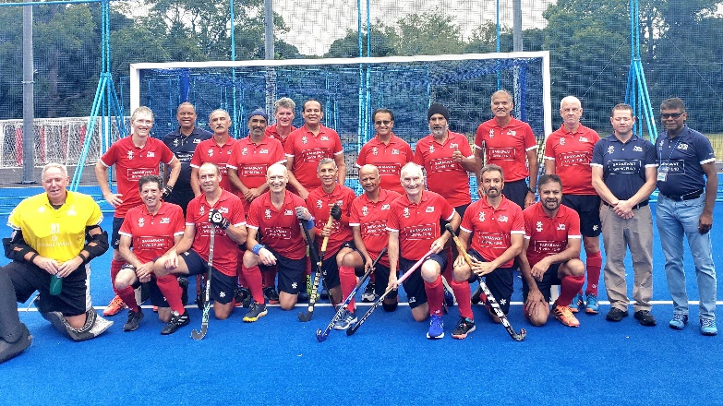
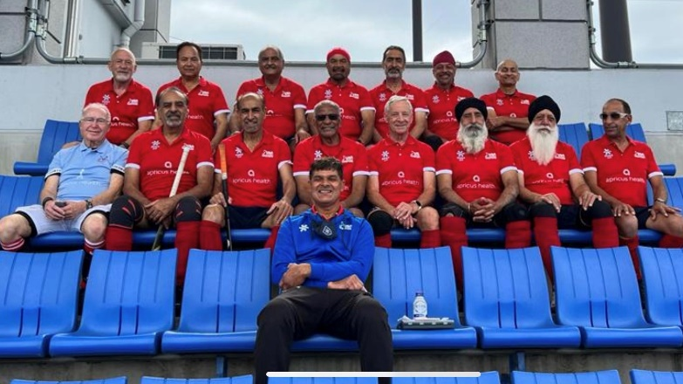
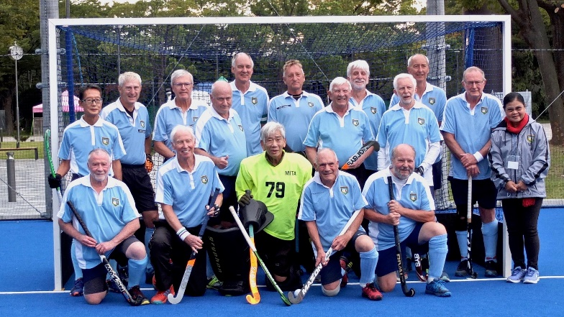
Teams – USA SoM - Alliance
USA O/60s
USA O/65s
Alliance O/70s
Manzar Iqbal
Peter Jones
Alexander Rooks
Chowdhry Abid
Brijinder Khosla
Peter Bale
Chamkaur Gill
Kewal Singh
Mahesh Saraswat
Ian Tapsall
Arvinder Virdee
13. Gurpreet Gill
14. Joost Douwes
15. Jaswinder Singh
22. Sankar Ramani
24. William Larkins
31. Jonathan O’Haire
32. Larry Zappone
Coach: Nigel Traverso
Manager: Stanley Iyadurai
Physio: Aaron Finer
1 | GRANAT rene (GK)
8 | STARFIELD Jeffrey
9 | EICHERT Lance
10 | BHOWRA Onkar
11 | SINGH Paramjit
12 | SERRETTE Alva (C)
13 | HUNDAL Waljeet
14 | DHUGGA Kashmir
15 | MICHAEL Darryl
19 | KOCH Todd
20 | RAZ Kavi
21 | SANDHAR Bhajan
22 | PREETINDER Brar
25 | SIDHU Kulwant
26 | SAHOTA Davinder
27 | MANGAT Raghbir
11 | NAKAMURA Kiyotaka
47 | KJEKSTAD Eric
52 | BUTTON Mike
79 | UMEZAWA Yoshimitsu
90 | FARGUS David
105 | BROWN Nevelle
136 | TRESISE Rod
146 | WALKER Norman
159 | LEARY Alan
170 | SONENBERG David
171 | WINNALL Steve
193 | DIENER Fredy
207 | WOOD Graham
213 | BARTON Michael
214 | JOHNSON Anthony
220 | PATON Glenn
BUTTON Penny | Manager
Wood Walaiporn | Manager
WOOD Graham | Coach
AKHTAR Amir | Manager
SERRETTE Alva | Coach

Slide 18
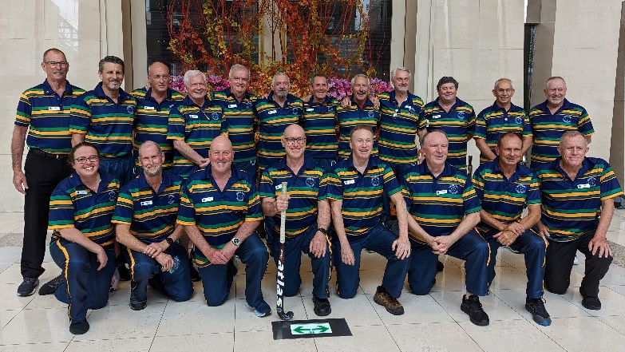
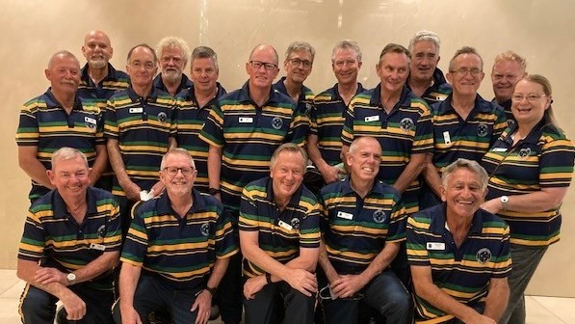
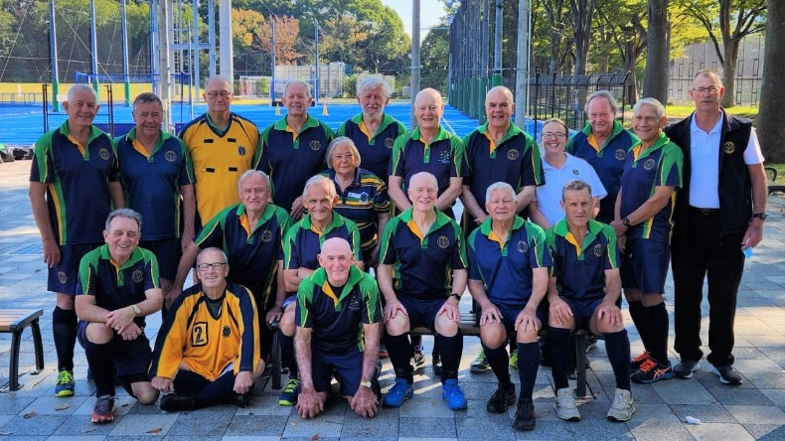
Spirit of Masters Teams – Southern Cross (Australia/New Zealand)
Southern Cross O/60s
Southern Cross O/65s
Southern Cross O/70s
Mark Studd
John Davis
Ian Harcla
Paul Marquardt
John Rogers
Mark Hulme
David Allen
Daniel Forman
Michael Butler
Mark Lester
Robert Malcolm
Darren McGiffen
Trevor Nicol
Tony Virtue
George Goodell
Ronald Lane
Brett Picknell
Coach: Robert Malcolm
Manager: Stephen Blakeley
Assistant Mng: Alistair McNab
Assistant Mng: Christine Hayes
Physio: Ross Swadling
Physio: Innalla Press
Bruce Cock
Mark Elliott
Wayne Harris
Thomas Karp
Garry Royle
John Lensink
Peter Hayes
9. Dannie Camilleri
10. Gregory Willcock
11. David Gorman
12. Stanley Hart
Ian Miller
George Naylor
Noel Mitchell
Eric Staak
22. David Hart
26. Andrew Terrey
Coach: Peter Hayes
Manager: Christine Hayes
Assistant Mng: Alistair McNab
Assistant Mng: Stephen Blakeley
Physio: Ross Swadling
Physio: Innalla Press
Marvin Heaston
Neil Waywood
Stephen Had
Thomas Long
Keith Platel
Kevin Keep
Michael Jenkins
Ross Gordon
Robert Ray
David Kennaway
Allan Harris
Peter Scharnberg
15. Gil Straayer
16. Bruce Winders
17. Scott Blackwell
24. John Ostaszewskyj
25. Ian Evans
Coach: Ian Evans
Manager: Marlene Matthews
Assistant Mng: Alistair McNab
Assistant Mng: Christine Hayes
Physio: Ross Swadling
Physio: Innalla Press

Slide 19
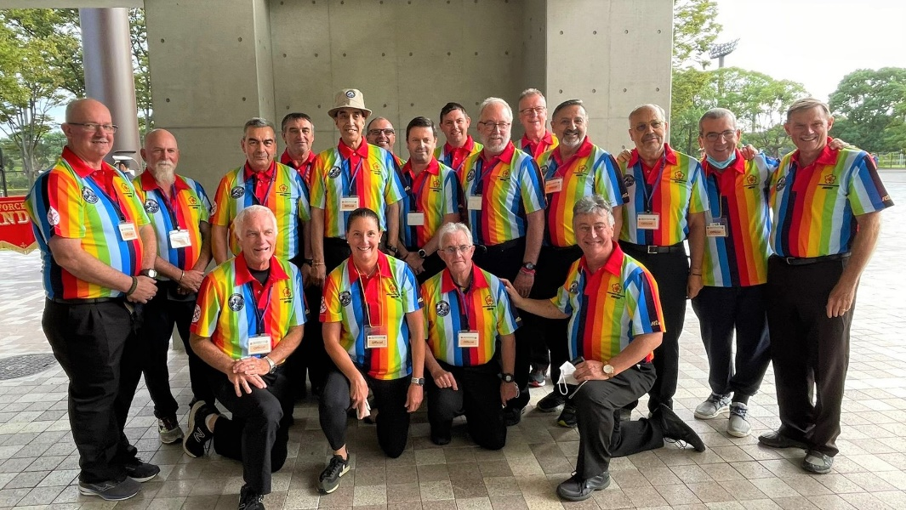
OFFICIALS & UMPIRES
HARRISON Fiona (ATD) | RSA
HIRAO Yutaka (ATD) | JPN
MAVRIDIS Anthony (ATD) | GRE
MASON Terry (AUM) | AUS
WATERMAN Alan (AUM) | CAN
KATO Naomi (AUM) | JPN
Technical Officials
HINCHLIFFE Jill | AUS
MACMILLAN Sue | AUS
SMITH Ian | AUS
WHITCHURCH Maree | AUS
KREUGER Markus | GER
ACRI Pietro | ITA
HALEY Merrill | RSA
BAYNE Lesley | WAL
HIRASAWA Miyuki | JPN
IMAJO Michiyo | JPN
KARIYA Kazuyo | JPN
MORI Yoshihiko | JPN
SEKINE Yumi | JPN
Umpires
ANDERSON Michael | AUS
CUTRALE Sam | AUS
HOCKEY Bruce (SX) | AUS
HURST Rod (SX) | AUS
MCMURRAY-W. Jockey | AUS
MILLAR Craig | AUS
ROSS David | AUS
WILLIAMS Neal | AUS
RANDHAWA Jasbir | CAN
MORALES Tony | ESP
BRADLEY Robert | ENG
CARTER Dan | ENG
SIHOTA Pritpal | ENG
LOGAN Mervyn | IRL
PINGITORE Salvatore | ITA
TOLOMEI Antonio | ITA
WELLS Andrew | NZL
BELCHER Clive (RSA) | RSA
CHILDS Paula (USA) | USA
SENNO Masato | JPN
KODAMA Shigeki | JPN
YUZAWA Nozomi | JPN
Umpires and Technical Officials
The Technical Director and Umpire Manager will be each be supported by several assistants,
and we will have over 50 umpires and officials working at the event, from across the world.
Technical Director
The TD for Tokyo is: Mr Kiyoshi SANA (JPN)
Umpires Manager
The assigned UM is: Mr John HERON (SCO)

Slide 20
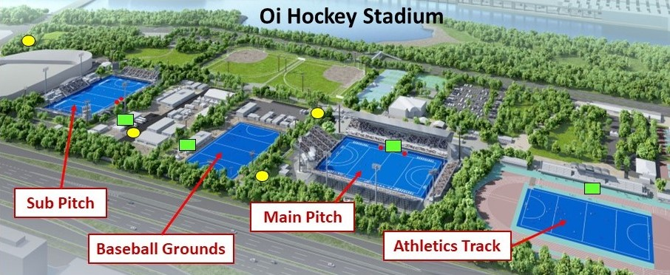
VENUE INFORMATION – 1 (OHS – Overview from West)
Oi Hockey Stadium
The hockey competition will be held at Oi Hockey Stadium in Oi Central Seaside Park next to Tokyo Bay. This was the venue for the Olympic hockey in 2021 at the historic, postponed Tokyo Olympics. The nearest train station is OiKeibajo-Mae on the Tokyo Monorail and is about 10-15 minute walk from OHS.
At Oi Hockey Stadium there are two Olympic-standard water-based pitches with the stand of the Main Pitch holding 2600 spectators, and the Sub Pitch stand holding 500 spectators. The two pitches are within the same park facility but separated by an area of baseball fields, requiring a walk of about five minutes or more from pitch to pitch. On some days members of the public will be using the other sporting facilities located within the park (baseball, tennis, dog-run), so we will often be sharing some of the pathways outside the pitch areas with local people.

Slide 21
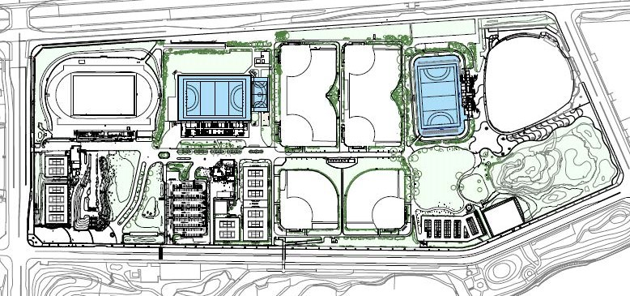
VENUE INFORMATION – 2 (OHS Venue Map – Eastern View )
Oi Hockey Stadium - Main Pitch
Sub Pitch
Half-Pitch
Ota Stadium
(Baseball)
S
Athletics
Baseball
F
C
Dog Run
Train Station
Tennis
Parking Area 1
Parking Area 2
Taxi Drop-Off
Red line indicates walking route from Station. ‘F’ = Food Trucks
‘C’ indicates Park Centre Office. ‘S’ indicates Convenience Store

Slide 22
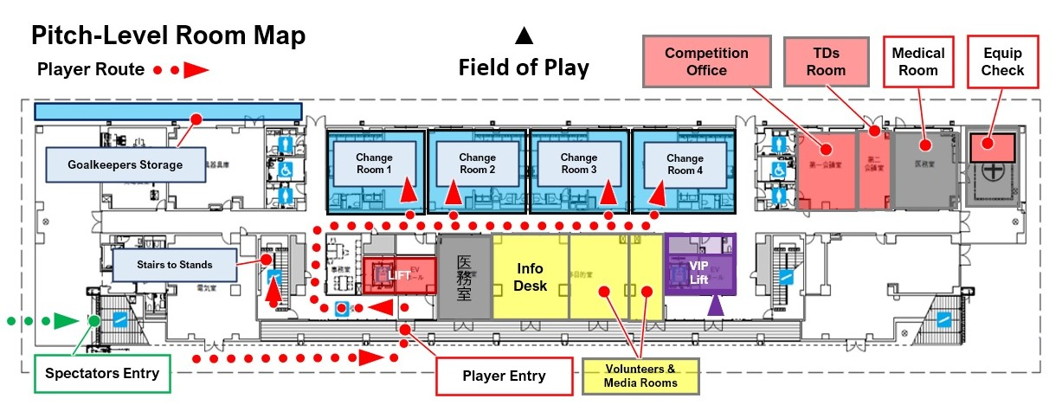
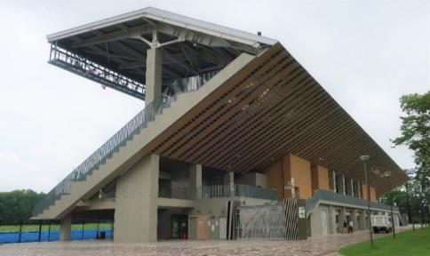
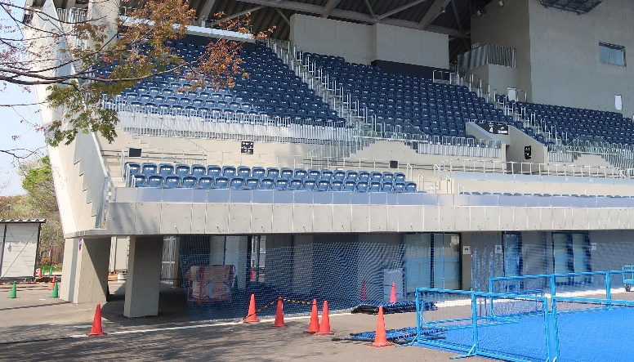
VENUE INFORMATION – 3 (OHS Main Pitch Rooms)
Undercover Area for Equipment Check

Slide 23
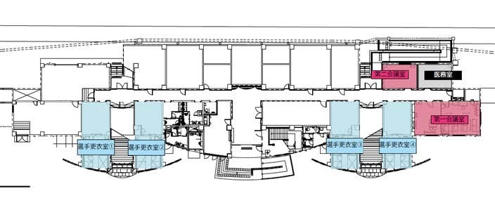
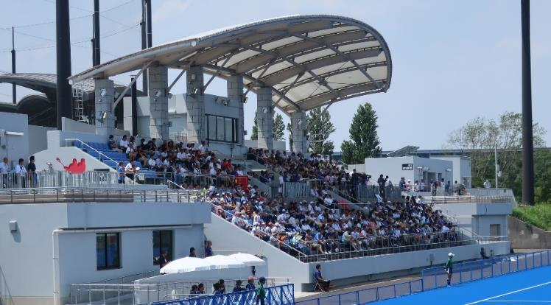
VENUE INFORMATION – 4 (OHS Sub Pitch Rooms)
Pitch-Level Room Map
▲
Field of Play
TDs Room
Medical
Room
Change Room 1
Change Room 2
Stairs to Stand
Change Room 3
Change Room 4
Competition Room
Player Route
Player & Spectator Entry
2nd Floor Seating
Route

Slide 24
TEAM INFORMATION - 2
Changing Rooms
We have eight (8) dedicated changing rooms for the tournament. A schedule has been prepared to allow every team to have 40 mins before the game (until 30 mins before centre pass) and 40 mins after the game (from 15 mins after end of game). Your individual team schedule will be shared with you in October. We ask that you respect other teams and try to keep to the times allocated and to leave the changing rooms in a condition that you would wish to find them. All changing rooms have showers, toilets, a whiteboards, and an ice machine. The main pitch has a physio bench in each room.
Goalkeepers Equipment Room
During the tournament, goalkeepers will be able to leave their equipment in a storage space under the Main Pitch stand. For security this area will be monitored by volunteer staff. Teams will be allocated their own space in the area, and we ask that teams be considerate when sharing this area and leave it as tidy as possible. Teams can also leave other heavy/large equipment such as practice balls and/or storage boxes in the space.
Video Recording of Matches
There will be designated locations at each pitch from which teams can video. However permission must first be granted for this. Please contact Tokyo HNOC. Mounting a GoPro on the fence behind the goal will probably be allowed.
Rubbish
There are few rubbish bins at the venue so we ask that everyone takes their rubbish with them where possible, please.

Slide 25
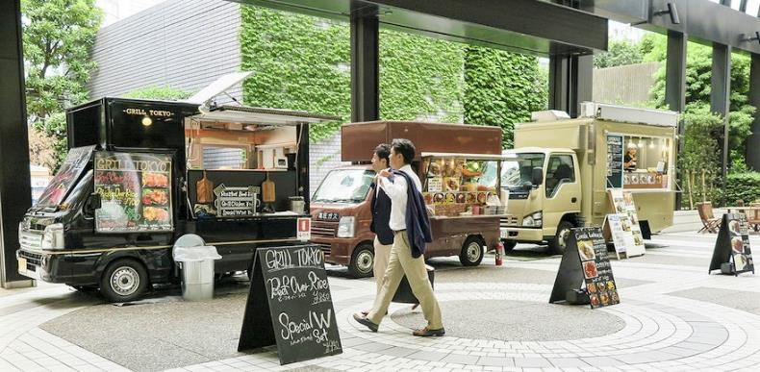
TEAM INFORMATION - 3
Team Liaison
Prior to the start of the tournament the main contact for team liaison is Kevin DEMPSTER who can be reached on kevin.d@iinet.net.au At the start of the tournament each team will be allocated a Team Liaison Officer (TLO) who will be available to support you with any issues you may be facing. Your TLO will be in touch with you when you arrive in Tokyo.
Information Desk
There will be several tournament Information Desks – one underneath the Main Pitch stand, and at some team hotels.
Lost & Found
Please ask at the Information Desks
Catering at Oi Hockey Stadium
Food vans/trucks will be stationed at the stadium each day of the tournament, offering various types of food, Drinks vending machines are also available in various locations around the venue.

Slide 26
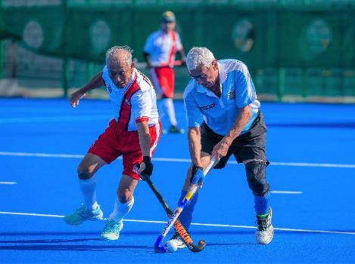
DIGITAL INFORMATION
Wi-Fi Tokyo City has free Wi-Fi points available around the venue, but these have limited strength.
Connect to FREE_Wi-Fi_and_TOKYO
Event Website
Our website is updated on a regular basis with information on the tournament and also new offers and ideas for how to make the most of your time in Tokyo. Please check in regularly to see developments before the tournament. You can also access additional services and activities that need pre-booking. https://mhwc2022tokyo.com/
Social Media
The Tokyo event will be posting on the WMH Facebook site as well as Twitter and Instagram. Please let us know when you have an update on your team. We would love to hear how your preparations and tournament are going.
Live Streaming
The final five days of the tournament will be live-steamed at the following YouTube ink:
https://www.youtube.com/playlist?list=PLkI5D8cMplFCU2TQ-hPelI_9kw5cPR7zL

Slide 27
EMERGENCIES & MEDICAL TREATMENT - 1
Health & Safety - Emergency Information
The Event Management Plan contains procedures for a range of potential incidents. Full details can be found on the Event website at the following link: https/OOOOOOOOOOO (TBC) . The procedures cover the following areas: Suspicious packages, Lost children or vulnerable adults, Major incident and evacuation plans.
In case of a major incident the Emergency Rendezvous Points are on the actual Hockey Pitches themselves. The areas will be signposted. In case of emergency, Event Management will use the venue speakers to direct people to the appropriate place.
Other urgent situations can be reported at any time to the Information Desk on the pitch-level floor of the Main Pitch stand, or to the Competition Office.
Medical Facilities
Medical services will be provided in the medical room, near changing rooms at both pitches as well as a response team on the FOPs when required. These teams will be backed up by services at one designated hospital. Medical services will be managed by a head doctor, and trained nurses, positioned at each pitch during competition.
Please note: Medical expenses are your responsibility. Please prepare your own protective measures, such as taking out overseas travel accident insurance.
Case 1
Injuries and changes in physical condition during a game
First Aid : Team Doctor and Physio support
Host Country Organizing Committee Medical Support
Contact : Dr. Takeo ARAI
Mail Address : mhwc2020tyo_med_arai@a05.itscom.net
Mobile Phone : 090-5783-9178
If hospitalization, examination, or (orthopaedic) surgical treatment is necessary, the HNOC doctor will request transport to an emergency hospital.

Slide 28
MEDICAL TREATMENT & COVID MEASURES - 2
Case 2
Fever/feeling unwell at the hotel and/or during daily activities
① Temperature check by individual
② Team Doctor examination/diagnosis
(or hotel/family doctor/examination)
Follow Tokyo’s latest infected person regulations link;
https://www.fukushihoken.metro.tokyo.lg.jp/english/visitors.html
Case 2 (continued)
HNOC Medical Organization Medical test kit prep instructions
The team representative will provide the name and symptoms of the infected person and report to Dr. ARAI.
In the event of a sudden change in condition while recuperating at the hotel, the patient will be transported to the hospital.
Case 3
If you need to be hospitalized during the tournament
Tokyo Shinagawa Hospital is recommended as a destination for hospitalization and outpatient treatment other than corona infection
Phone : 03-3764-0511
Address : 140-8522 Shinagawa-ku Higashioi 6-3-22
Postscript
Each team should prepare a considerable number of thermometers (electronic thermometer) and COVID19 (Corona) antigen test kits. HNOC will also prepare thermometers, & antigen test kits.

Slide 29
COVID MEASURES (Precautions)
Protective Measures against COVID19 Infection at WMH World Cup 2022 Tokyo
1. Reminder to the Participants
* All participants should monitor their own health carefully by checking their temperature daily and reporting any signs of sickness.
* Teams should carry Rapid Antigen Testing kits for checking any members will COVID symptoms.
* Team members including Players, Team Managers, Coaches, and other Team Officials should refrain from participating in that day’s competition when they detect any health problems.
2. COVID Infected Participants must:
* Immediately report their condition to the HNOC if they test positive for COVID.
* Positive cases must follow the regulations set out by the City of Tokyo for infected persons.
* The HNOC will meet and decide about the patient’s further participation in the Tournament.
3. Precautions Outside the Hockey Stadium
* It is strongly requested that participants wear a mask when they are using public transport and taxis.
* Please also wear a mask in hotel lobbies, restaurants, & shops.
4. Precautions Inside the Hockey Stadium
* There will be a temperature check and hand-sanitation station at the stadium entry.
* If a fever higher than 37.5C is detected, the person will be asked to not enter the stadium.
* Team Meetings should be held outdoors as much as possible.
* Please wear a mask when moving between the two pitches.
5. Precautions During a Match
* Teams should avoid sharing equipment, and should disinfect equipment where sharing is unavoidable.
* Protective Face Masks for PCs must be have identification for use by individual players.
* Team Bench officials should sit apart where possible and wear a mask. They should refrain from shouting.
* Each team must clean and disinfect the bench after their match.
* Each team must clean their changing room before they leave.

Slide 30
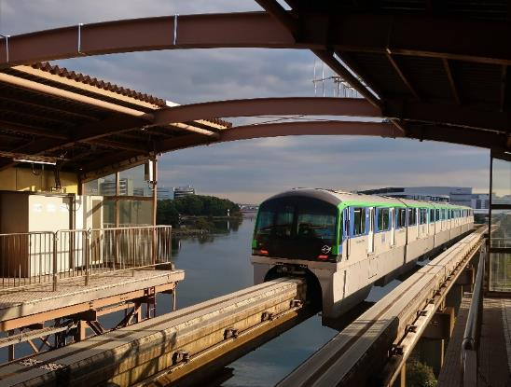
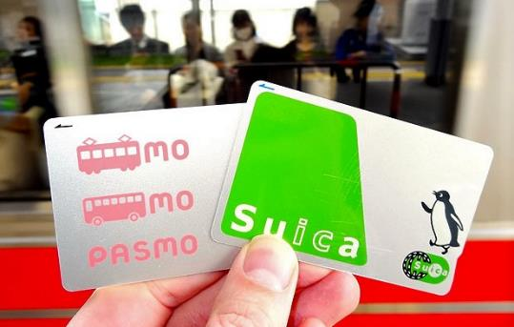
TRANSPORT - 1
Getting to the Venue
The venue is easily accessible by public transport, especially with Tokyo’s extensive system of trains and subways. Taxis are also readily available.
Train Access
The nearest train station is OiKeibajo-Mae on the Tokyo Monorail and is about 10–15 minute walk from the hockey stadium. The next nearest station is Tachiaigawa Station on the JR Keikyu line which takes a 25-30 min walk.
Train Pass Cards
The easiest way of getting around on the trains and subways is with a pass card which you just tag on and off at the station entry gate. The ‘Suica’ card and ‘Passmo’ cards are the most popular, and can be purchased (and recharged) at ticket machines near the entry gate. A new card costs ¥500, and can also be used like cash card at kiosks and vending machines.

Slide 31
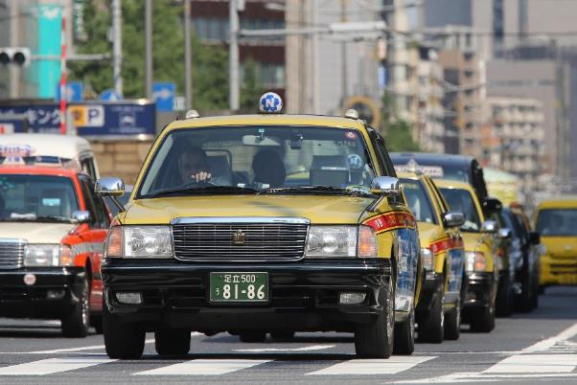
TRANSPORT - 2
Local Taxi Companies
Local taxi companies: (or easily hailed from roadside)
Nihon Kotsu 03-5755-2336 (English OK)
Taxi Checker 03-3573-3751 (Japanese)
Tokyo Musen 03-3361-2111 (Japanese)
Musen Haisha Centre 03-3406-7171 (Japanese)
Venue Address
Oi Hockey Stadium 大井ふ頭中央海浜公園ホッケー競技場
Oi Futochuo Keihin Koen (Oi Park) 大井ふ頭中央海浜公園
4-1-9 Yashio, Shinagawa-ku, Tokyo 品川区八潮４丁目 1-19
Postcode 140-0003
Parking at OHS
Limited parking facilities are available at the hockey stadium sports park. Please see the map on Slide 13 for the two locations. The cost is ¥200-300 (TBC) per hour.

Slide 32
SOCIAL & ADDITIONAL ACTIVITIES - 1
Tournament Dinner
We are delighted that Japan Masters Hockey will be hosting the Tournament Dinner on Friday 28th October. You will be receiving a separate invite to this event. Please ensure that each of your Team Managers have received this information. The event will start at 5:30pm and will be held at Meiji Kinenkan Garden in central Tokyo.
Opening & Closing Ceremonies
The tournament will be formally opened on Tuesday 18th October. The ceremony will take place on the Main Pitch at 3pm at OHS. All national and team squads are expected to be represented to formally open the tournament.
Following completion of the last final, the tournament will be formally closed in a ceremony hosted by World Masters Hockey and Japan Masters Hockey. This will take place on Saturday 29th October on the Main Pitch at OHC from 4:00pm

Slide 33
TRAVEL & SIGHTSEEING - 1
Tokyo Airports
For international travellers flying into Japan, Tokyo has two international airports – Narita & Haneda. Both of these airports are well serviced by transport facilities into downtown Tokyo.
Distance and time from airport by train to central Tokyo:
Narita Airport – 70km in 60 mins (Direct train)
Haneda Airport – 20km in 30 mins (One train change)
Narita is larger with more facilities and more international airlines. Limousine express buses are also available from each airport, and take about the same time.
Further information can be found on the airport websites:
Narita：https://www.narita-airport.jp/en/access
Haneda：https://tokyo-haneda.com/en/access/index.html
Japan Rail Pass
If you plan to travel around Japan during your visit for the World Cup, the best way to get around is by the super-express ‘Bullet Train’. So it is highly recommended that you purchase a ‘Japan Rail Pass’, because it can save you a lot of money. The Rail Pass is available for one-week, two-week, or three-week periods. The cost of a one-week pass is about the same as a round-trip ticket from Tokyo to Kyoto, but you would then have the cost-free option of travelling ANYWHERE else in Japan, and on many local lines and buses too – not only bullet trains. A voucher for a Rail Pass needs to be purchased from a travel agent in your home country before coming to Japan. More information can be found at：https://japanrailpass.net/en/

Slide 34
TRAVEL & SIGHTSEEING - 2
Tokyo City
..is the largest metropolis in the world, with its unique contrasts in ancient and modern architecture – including temples & gardens, and the Emperor’s Palace. Climb Tokyo Skytree or cross Rainbow Bridge on a driverless train. Then Tokyo really comes alive at night with it’s spectacular neon streets. Exploring is easy with Tokyo’s extensive system of trains and subways.

Slide 35
TRAVEL & SIGHTSEEING - 3
Tokyo’s Surrounding Areas
There are some great day-trips outside of Tokyo. Head to Tokyo Disneyland in nearby Chiba prefecture, or see the giant Gundam robot in action in neighbouring Yokohama City. Visit the Cup Noodles Museum there too. Further away you might get a glimpse of Fuji-san in Hakone. Then there is the majestic big Buddha in Kamakura. To the north there is Nikko with it’s incredible decorative temples and gorgeous waterfall. Enjoy!

Slide 36
TRAVEL & SIGHTSEEING - 4
Shinagawa City – Home of the Olympic Hockey Stadium
OHS is located within the Tokyo city ward called Shinagawa. As an important stopover from Tokyo on one of Japan’s main travel routes, the Shinagawa area was historically a busy hub for travellers and merchants. Nearby Tokyo Bay also provided water traffic and seafood resources. Even today there are still remnants of this history, including famous temples and shrines, and a few old shops and inns.
Local tourist services can offer a number of cultural ‘experiences’ including bay-cruising on a traditional ‘dinner-boat’, a Buddhist zazen session, tea ceremony, lacquer-ware or traditional sweets-making. There will be a information booth from Shinagawa City at OHS to assist you with sightseeing ideas and booking tours. Click here!
https://shukuba.jp/hockey/

Slide 37
TRAVEL & SIGHTSEEING - 5
Shinagawa - Home of Hockey…. And Horse Racing!
The area near the hockey stadium is also very famous among Tokyo people for it’s horse racing venue - Oi Keibajo. There aren’t any actual races while the World Cup is on, but you can still enjoy the well-known colourful night-time illuminations at the track (Sat Oct 22nd & Sun 23rd Oct)
All World Cup participants will be receiving a Free Ticket at the Hockey Stadium on October 18th for the illumination show!

Slide 38
GENERAL INFORMATION - 1
Weather & Temperatures in October
Autumn is the best time of year to visit Japan, with comfortable temperatures 25-15°C. You will need a light jacket and a warm undershirt for the cooler days. Predictions are that this October may be a little wetter than usual so bring a fold-up umbrella just in case. Also bring a hat, sunscreen, and sunglasses for the sunnier days.
Electricity and Sockets
The voltage in Japan is 100V while the frequency is 50Hz/60Hz in Japan and 50Hz in Tokyo. The sockets, as illustrated, will be used in all buildings and are compatible with A type plugs (the type with a two flat pins). Multiregion adaptors will be available to purchase at nearby convenience stores. Foreign appliances will most likely require adapters and/or transformers.
Tap water
Tokyo’s tap water is completely safe to drink and conforms to strict quality regulations. Bottled water is also available at convenience stores and out of the seemingly endless number of vending machines.
Language
Standard Japanese is the main language in Japan, but Tokyo is becoming a much more foreigner-friendly city. Especially in the major tourist areas, English can be generally understood.
Shinakamon – Seagull mascot for Shinagawa city

Slide 39
GENERAL INFORMATION – 2
Money
The yen (JPY, ¥) is the currency of Japan. Bills come in denominations of 10,000, 5,000, 2,000, and 1,000, although 2,000 bills are rare. Coins come in denominations of 500, 100, 50, 10, 5 and 1.
Banks and ATMs
If you want to withdraw money from your own account in yen, many international banks have at least one Tokyo branch. Most major Japanese banks now accept international cards at their ATMs, as do the Japan Post Bank ATMs found in post offices. ATMs can also be found inside most convenience stores and shopping centres.
Changing money
Money can be exchanged at currency exchange counters located mainly at banks, post offices, hotels and airports.
Credit cards
Most major credit cards are accepted at major stores and facilities. When checking in to a hotel, they serve as identification in lieu of a cash deposit. Note, however, that there are still a few facilities do not accept credit cards at all, and others may accept only certain types, so it is advised that you carry some cash at all times.
Tipping
There is no tipping culture in Tokyo, so the final bill you receive at cafes, bars and restaurants is the final price that you need to pay. In some restaurants, a fixed percentage service charge is added to the bill.

Slide 40
GENERAL INFORMATION – 3
Free Wi-Fi Services
Free Wi-Fi is becoming increasingly available throughout the city. Many major hotels, coffee shops, restaurants and public facilities offer a free Wi-Fi service. However, for guaranteed internet access wherever you roam, pocket- Wi-Fi devices are available for rent from kiosks at the airport, or pick up a travel sim to fit into your existing phone.
Tokyo Free Wi-Fi
Where: Around Tokyo
How: Select the ‘FREE_Wi-Fi_and_TOKYO’ SSID, launch your web browser, tap “Access the Internet here” and follow the instructions on the screen.
Metro Free Wi-Fi + Toei Subway Free Wi-Fi
Where: 210 subway stations in Tokyo
How: Select the ‘Metro_Free_Wi-Fi’ or ‘Toei_Subway_Free_Wi-Fi’ SSID, launch your web browser, and follow
the instructions on the screen.
Telephone Services
The country code for Japan is 81. When calling from outside of Japan, dial the international dialling access code, which differs by country, then dial 81.

Slide 41
GENERAL INFORMATION – 4
Noise
Tokyo and Oi Hockey Stadium can be a noisy place! The hockey stadium is in the direct approach line path for nearby Haneda Airport so there are times when there is continuous noise from multiple planes coming in to land - with some planes flying directly over the stadium. The large flock of squawking crows which live at the stadium don't seem to mind though.
Typhoons
October is the end of the typhoon season, but if one hits Tokyo, it could bring destructive winds and flooding, causing competition to be disrupted for a day or so. Fortunately we have forecasting systems which can monitor such storms many days before they arrive. So please heed any warnings to stay indoors at such times.
Earthquakes
Japan is a land of frequent earth tremors - most being very minor and almost undetectable. However if a very severe earthquake occurs, you must take precautions to protect your life. Indoors and outdoors watch out for falling objects and protect your head. Alarms will sound but avoid panicking, as this can cause injury. Fires could also be triggered so be ready to evacuate if instructed to do so. The evacuation area at OHS will be on the hockey pitches themselves. If you are travelling near the coastline, beware of tsunami warnings which may require you to evacuate to higher ground. Tokyo Bay near OHS is mostly a safe area from tsunamis.
Emergency Phone Numbers
If you find yourself in need of assistance, dial the appropriate number : Police 110, Police (English) 03-3501-0110. Fire Emergency/ Ambulance 119
On many street corners, small police boxes - known locally as 'Koban’, support the local area. Drop in for directions, lost and found, or any traffic related incidents.

Slide 42
THANK YOU!
Enjoy your hockey in Tokyo!

